Slide 1

Moving on up to the cloud, with a PostgreSQL database in the sky
John Miner Data Architect
john.miner@insight.com

Slide 2



1970 Television Sitcoms
https://tinyurl.com/yn9xu97t

Slide 3
Purpose
Many companies are looking to reduce licensing costs by moving databases currently written for SQL Server to PostgreSQL. What are the technical pitfalls you might encounter when moving not only the database schema but re-factoring the code?
Migrating the schema and data from one database system to another is not hard. However, the old saying of “garbage in equals garbage out” applies to both views and stored code.
These two types of pre-compiled code will challenge the developer to use their skills to decipher code written years ago and convert it to modern day code that is performant, uses intermediate steps for debugging and uses logging for run time metrics.

Slide 4
Topics – Migration Methodolgy
Inventory Databases
Baseline Resource Usage
Deploy Infrastructure
Move Tables and Data
Redesign Stored Code
Other Topics

Slide 5
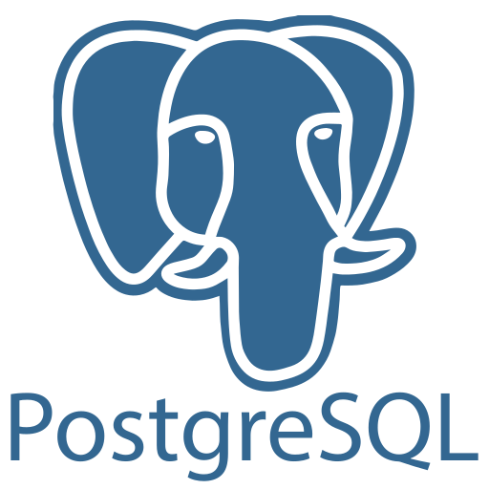
History Lesson
1986 - Berkley POSTGRES project - led by Professor Michael Stonebraker. The effort was sponsored by many different government grants.
1995 - Andrew Yu and Jolly Chen added an SQL language interpreter to database engine. It was released as Postgres95 as open-source descendant of the original project.
The database engine was re-written in ANSI C for speed. In 1996, the name was changed to PostgreSQL

Slide 6
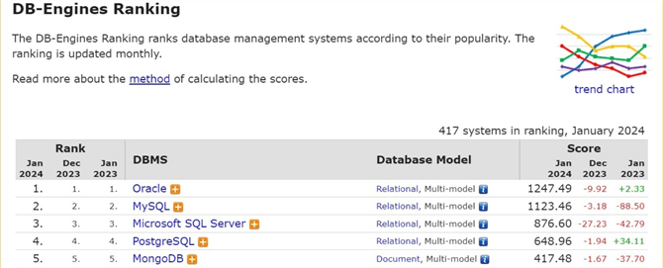
Why learn PostgreSQL
The number of popular database engines can be counted on one hand.
Knowing the top 4 databases will make you more marketable.
I decided to learn PostgreSQL since it is open source.

Slide 7

Database Inventory
Every database migration starts with an inventory.
Ask the SME questions to understand the project.
How many databases? - current size vs expected growth
Are the databases OLTP or OLAP? - dictates storage options
Are the databases tightly coupled? - cross database queries
Do you need HA and/or DA? - defines infrastructure
Additional configuration? - full text index or geo-spatial features?

Slide 8

Baseline Resource Usage
How much memory allocated vs used?
How much storage used vs available?
What are the IOPS on current system?
How many connections per hour?
Are there performance issues?
* When possible, use a tool to collect the data of the old vs new system.

Slide 9
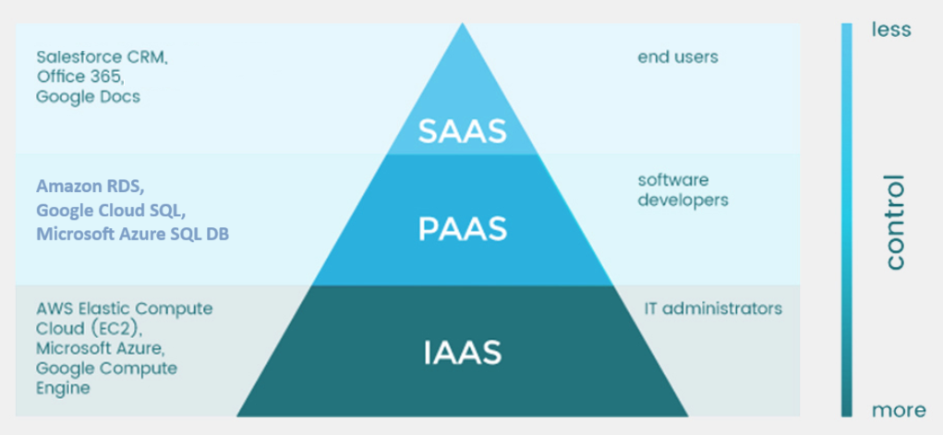
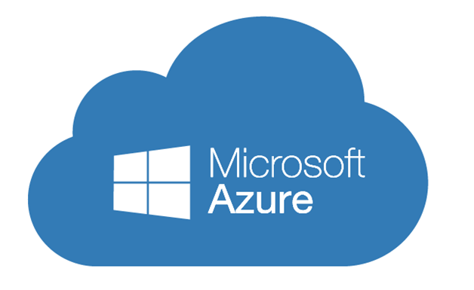


Cloud Service Choices
* Decide between IaaS (more control) and PaaS (less control).

Slide 10



Infrastructure Deployment
One time versus multiple deployments? Use the portal for a one time install. Write infrastructure as code for multiple deployments.
Decide upon your DevOps language. Some popular tools are “arm templates”, “azure cli”, “aws cdk”, and “terraform”.
Pick a framework. Some popular workflow pipelines are “ADO pipelines”, “git hub actions”, and “jenkins”.

Slide 11
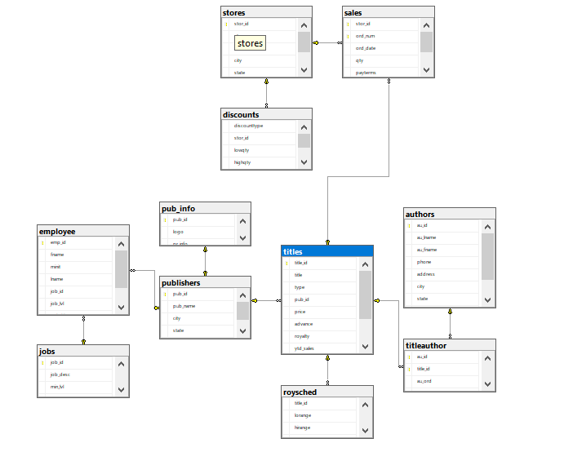
Pubs Database
This sample database was deployed with Microsoft SQL Server 7.0.
Simple example on how to migrate a local MS SQL database to the cloud.
Tasks:
Script tables
Script data
Convert SQL code

Slide 12
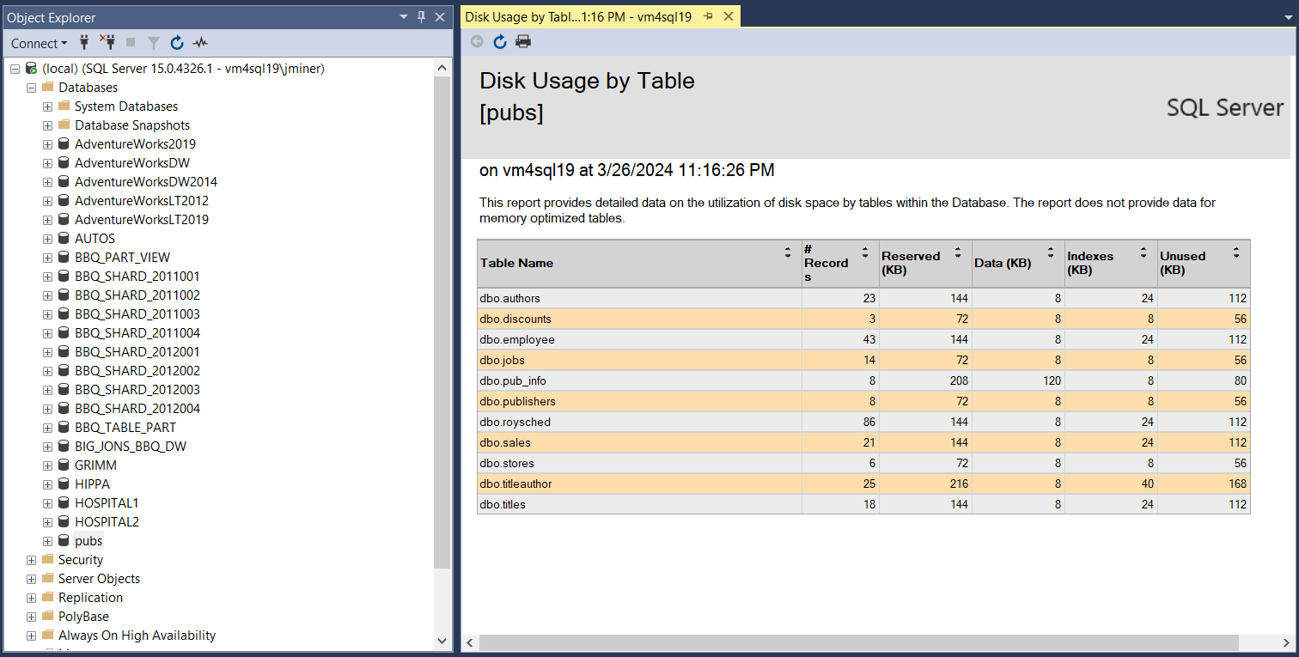
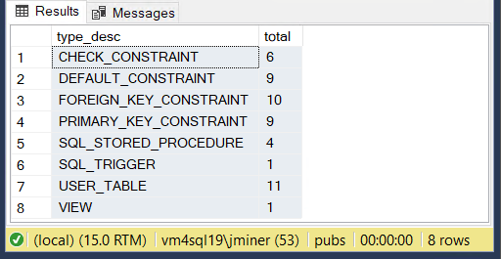
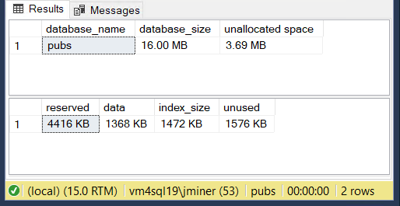
Inventory database
The pubs database is tiny.

Slide 13
Convert Table Definitions
There are several options for the developer. You can look around for a 3rd party product, use freeware or recode the DDL by hand. Listed below are two freeware products.
I have used the sqlserver2pgsql Perl script in the past. It is easy to use and will demo today.
The python class called sqlglot was written to translate code between PySpark and Presto. It supports 18 different dialects of SQL and on my list to learn.
demo 1 – Perl script

Slide 14
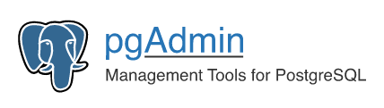
Database Tools
The pgAdmin graphical administration tool is like SSMS and psql is an interactive command line tool.
Scheduling can be done with the pgAgent extension for a virtual machine or the cron extension for the Azure Service.
The database has drivers for both ODBC and JDBC which is handy when writing ETL.

Slide 15
Create Empty Tables
I have chosen to use Azure SQL Database’s flexible server offering for the infrastructure.
The output from the Perl script allows for the tables to be defined without constraints (FK, PK).
PostgreSQL supports the public schema instead of dbo. But you can define one if you want.
There is no control over placement of files using PaaS. But one can use tablespaces if you are using IaaS. This will give you control of which directory files are stored in.
demo 2 – create schema + empty tables

Slide 16
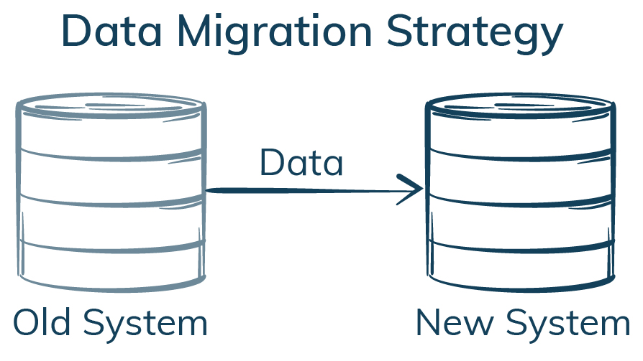
Migrate Data
There are many ways to move data. Today, I am going to demonstrate two ways to populate the empty tables.
The pubs database is very small. We can just create insert statements using the SSMS tool.
Another golden oldie is to use an SSIS package with the correct ODBC driver.
demo 3 – migrating data

Slide 17
Modernizing Code
This is the hardest part of the migration. Here are some differences to be aware of.
database is case sensitive (ILIKE).
coding supports multiple languages (pgSQL, Tcl, Perl, and Python).
expanded set of data types (arrays)
different statements and variable scoping
support for indexing (B-Tree, Hash, GiST, SP-GiST, GIN, BRIN)
Going back to the inventory, we have 4 stored procedures, 1 view and 1 trigger in the tops. Suggest to use pgSQL for coding.
demo 4 – redesign stored code

Slide 18
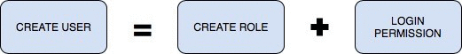
System Access
A database without any users is not useful. Most database have logins, users and roles. PostgreSQL just has roles.
PostgreSQL supports the grant, alter, and revoke statements for permissions.
Also, the database supports server and database roles.
demo 5 – creating users

Slide 19
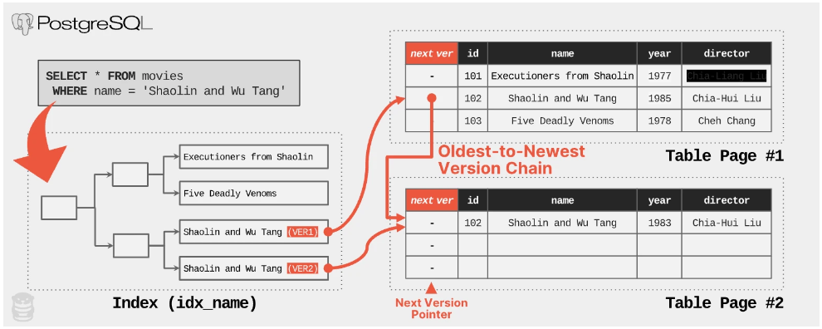
Multi-Version Concurrency Control (MVCC)

Slide 20
Issues with MVCC
Design:
The MVCC database uses append only storage with auto vacuum.
Issues:
Full copy of tuple.
Results in table bloat.
Causes index bloat.
Auto-vacuum process required.
* - Oracle and MySQL store tuple deltas which take less space.

Slide 21

System Monitoring
Use the pg_stat_statements to get insights into query executions for IaaS deployments.
Configure the query store via the Azure portal for PaaS deployments.
For those of us who are old school, use a log table for huge stored procedures. Break the code into restartable chunks using temp tables.
Regardless of technique, collecting statistics and finding the rouge query easily are part of the DBA job.

Slide 22


Other Topics
Replication using publication / subscription.
Full text search with vectors and indexing.
High availability using synchronous replication and standby server.
Use the GIS extension for geo-spatial data types.
Look at Liquid Base or Fly Way for deployments.
Backups handled by service. Must roll your own when using a virtual machine. The vacuum service handles fragmentation.

Slide 23
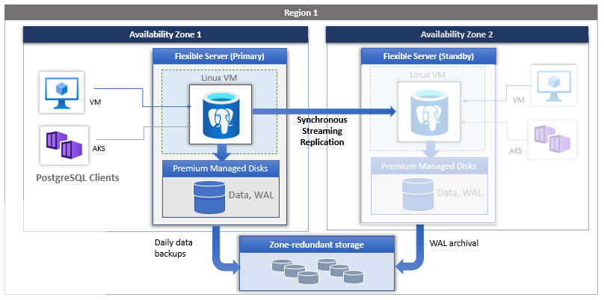
High Availability – Azure SQL DB - Flexible Server

Slide 24
Summary
The PostgreSQL database is an open-source product available for deployment all three cloud vendors. This means you can eliminate your licensing costs when creating solutions.
The methodology for migrating a historical SQL Server database to the Azure cloud has the following steps: inventory databases, determine dependencies, migrate tables, load data, install constraints, and deploy re-written SQL code. While there are tools to help you on this journey, a good understanding of the pgSQL language is a must.
The multi-version concurrency control design used in PostgreSQL can cause bloat in both tables and indexes. However, the auto vacuum service fixes the issue at the cost of maintenance time.
Adding PostgreSQL to your skillsets is one way to make yourself marketable.

Slide 25
References - Page 1
History of PostgreSQL
https://tinyurl.com/46527xkw
DevOps Tools
https://tinyurl.com/jfkpke9f
Perl Conversion Script
https://tinyurl.com/495pjnv7
Strawberry Perl
https://tinyurl.com/3abbyrfa
Client Tools
https://tinyurl.com/avcja3ud
ODBC Driver
https://tinyurl.com/57xkcajx
JDBC Driver
https://tinyurl.com/35ccv5re
psSQL - Indexes
https://tinyurl.com/6ns276fu
pgSQL - Language
https://tinyurl.com/mt67s8n5
MVCC
https://tinyurl.com/456p4877

Slide 26
References - Page 2
Statement Statistics
https://tinyurl.com/4buyuv33
Query Store
https://tinyurl.com/4c3my745
Replication
https://tinyurl.com/2s56hrde
Full Text Search
https://tinyurl.com/vp5b2add
High Availability
https://tinyurl.com/3hvjd8c4
PostGIS
https://tinyurl.com/3325hwa3
Liquid Base
https://tinyurl.com/yeabz4yt
Fly Way
https://tinyurl.com/bdd9xvvd

Slide 27
Questions / Thank You

